Slide 1
Data Mining
Support Vector Machines and
Ensemble Techniques

Slide 2
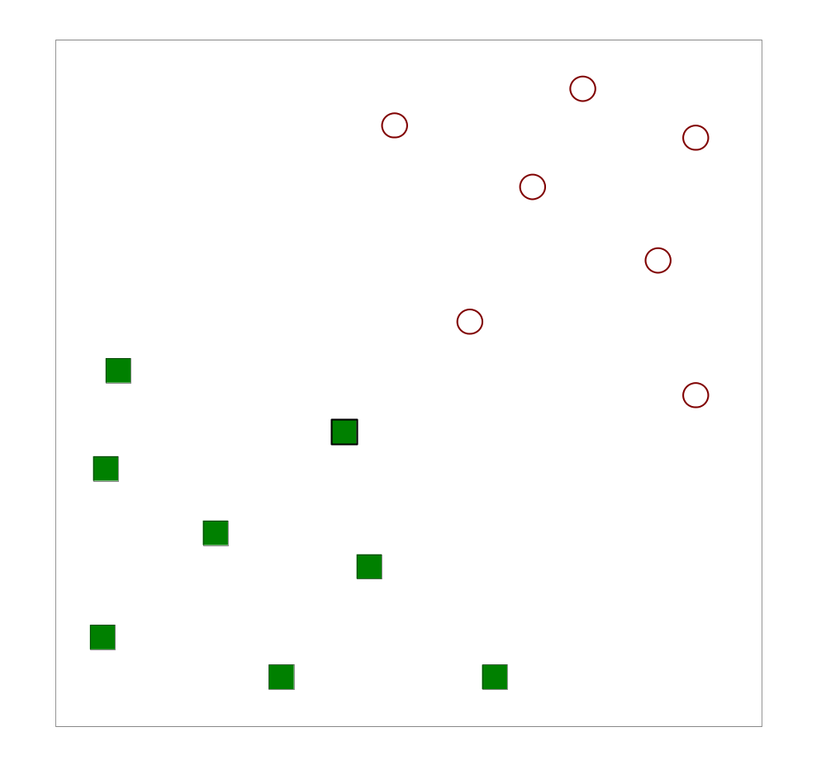
Support Vector Machines
Find a linear hyperplane (decision boundary) that will separate the data

Slide 3
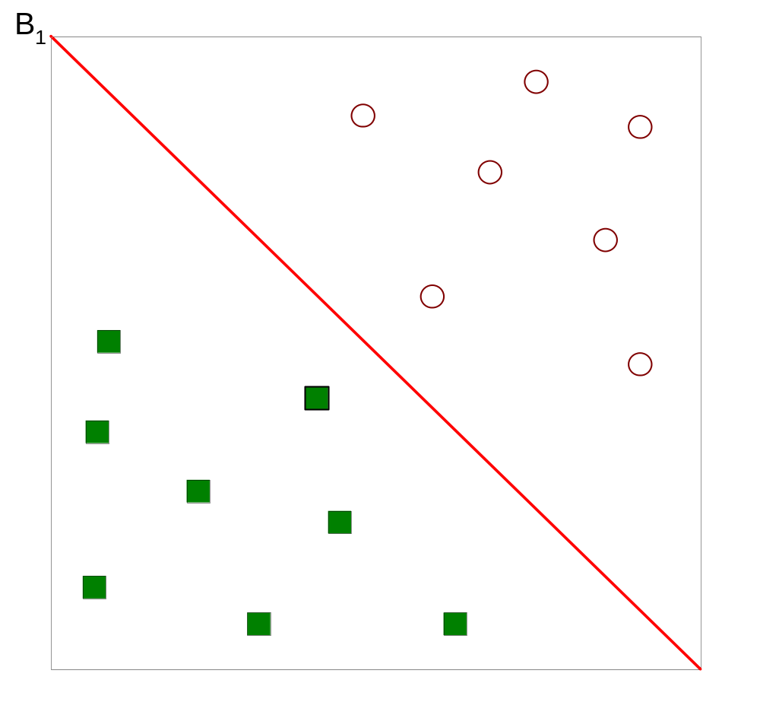
Support Vector Machines
One Possible Solution

Slide 4
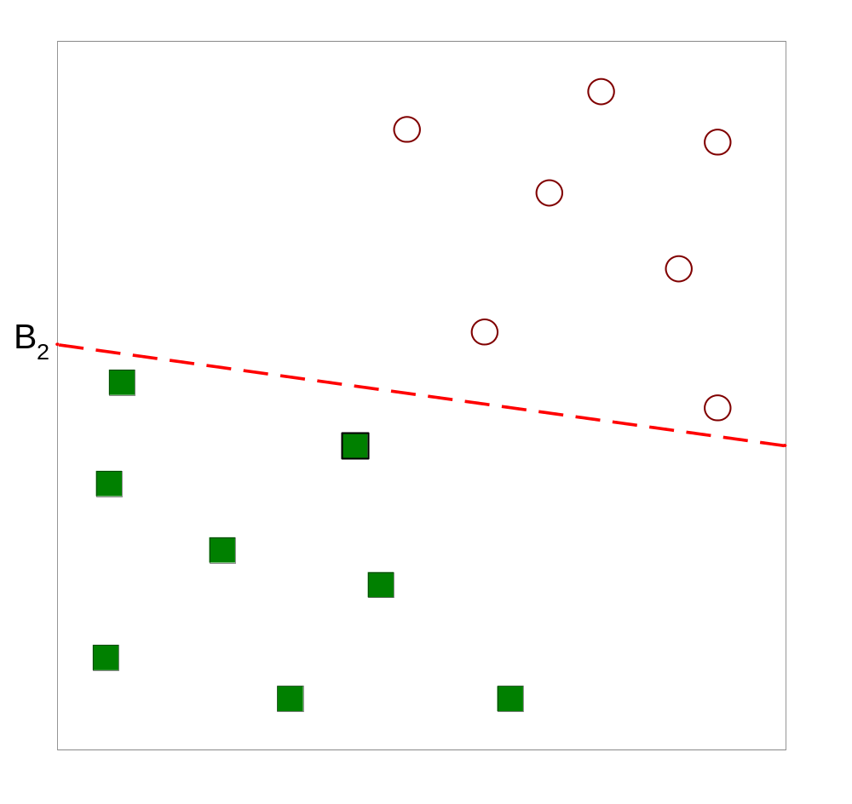
Support Vector Machines
Another possible solution

Slide 5
Support Vector Machines
Other possible solutions

Slide 6
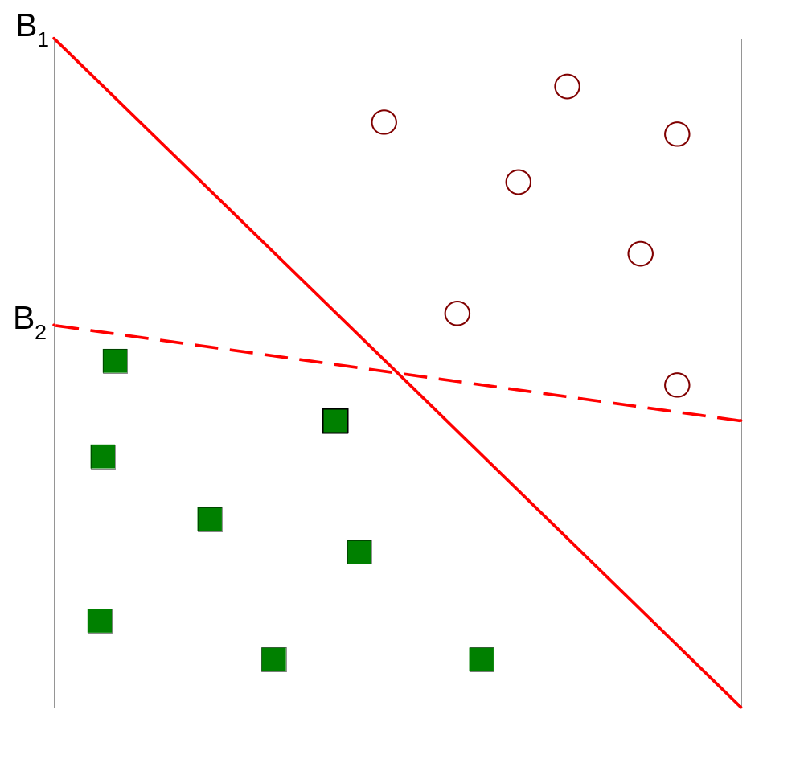
Support Vector Machines
Which one is better? B1 or B2?
How do you define better?

Slide 7
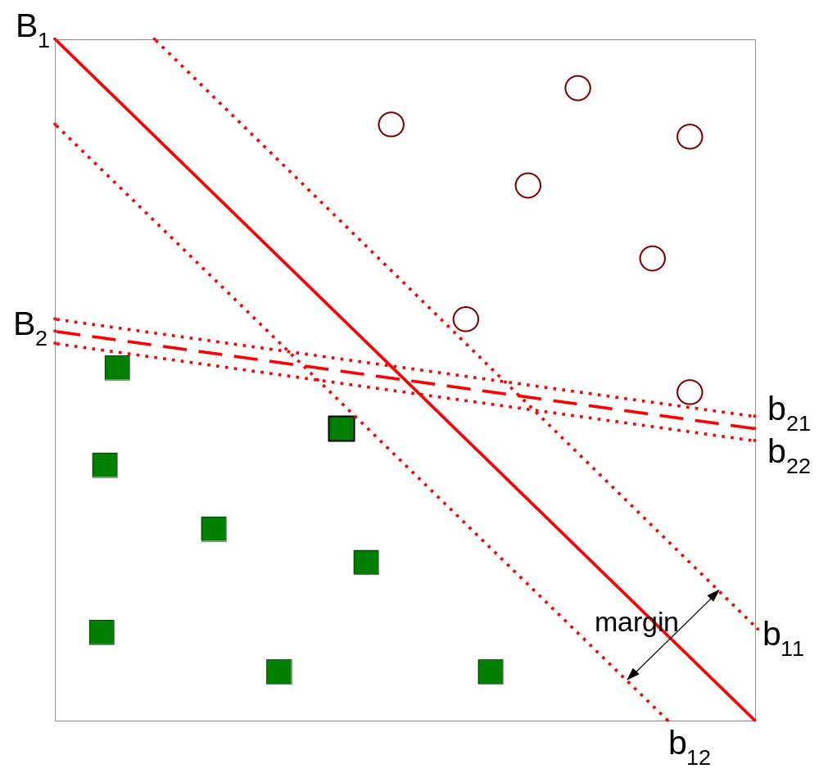
Support Vector Machines
Find hyperplane maximizes the margin => B1 is better than B2

Slide 8
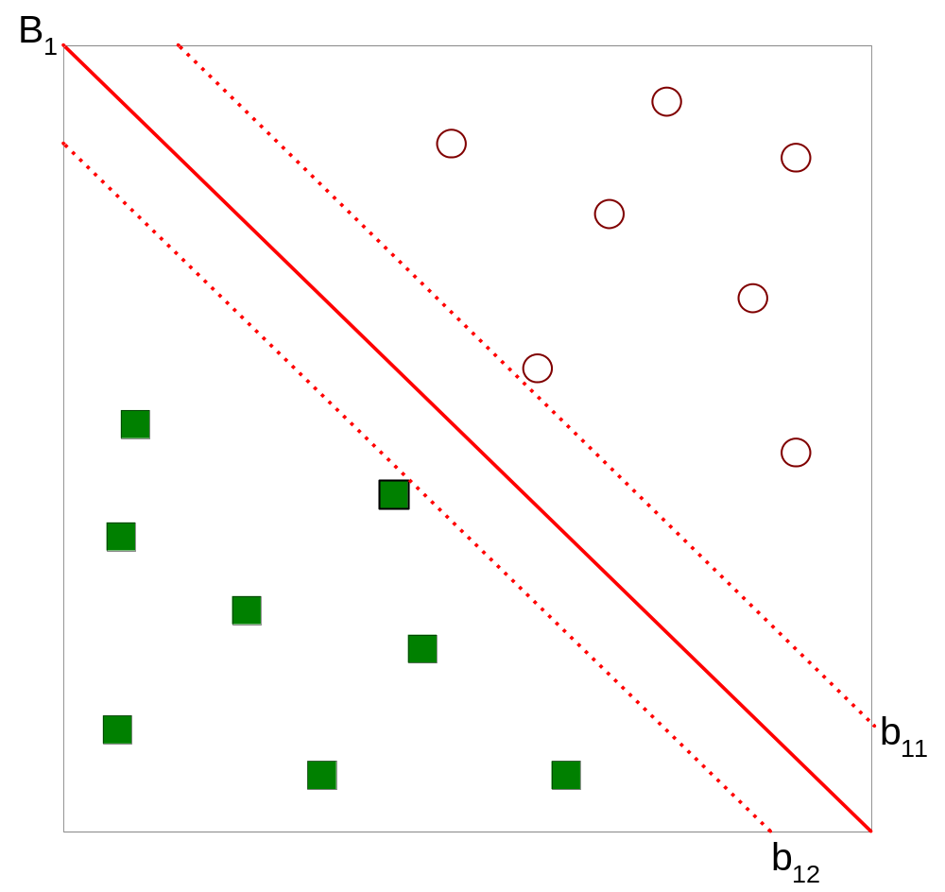



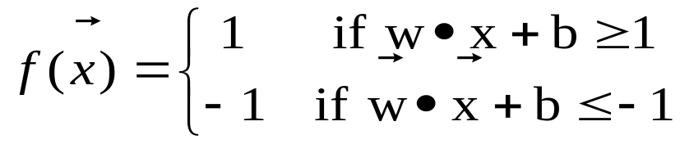
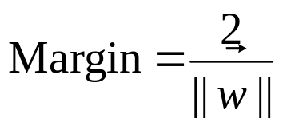
Support Vector Machines

Slide 9

Linear SVM
Linear model:
Learning the model is equivalent to determining the values of
  How to find from training data?

Slide 10

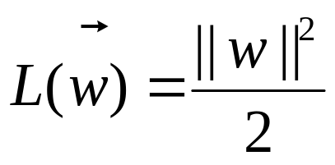
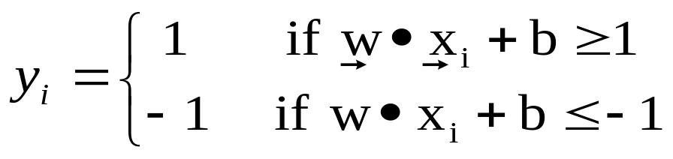
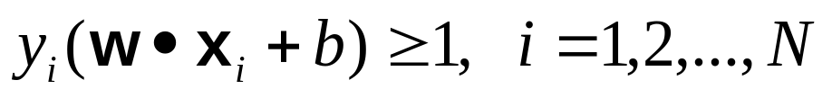
Learning Linear SVM
Objective is to maximize:
  Which is equivalent to minimizing:
  Subject to the following constraints:
  or
    This is a constrained optimization problem
      Solve it using Lagrange multiplier method

Slide 11
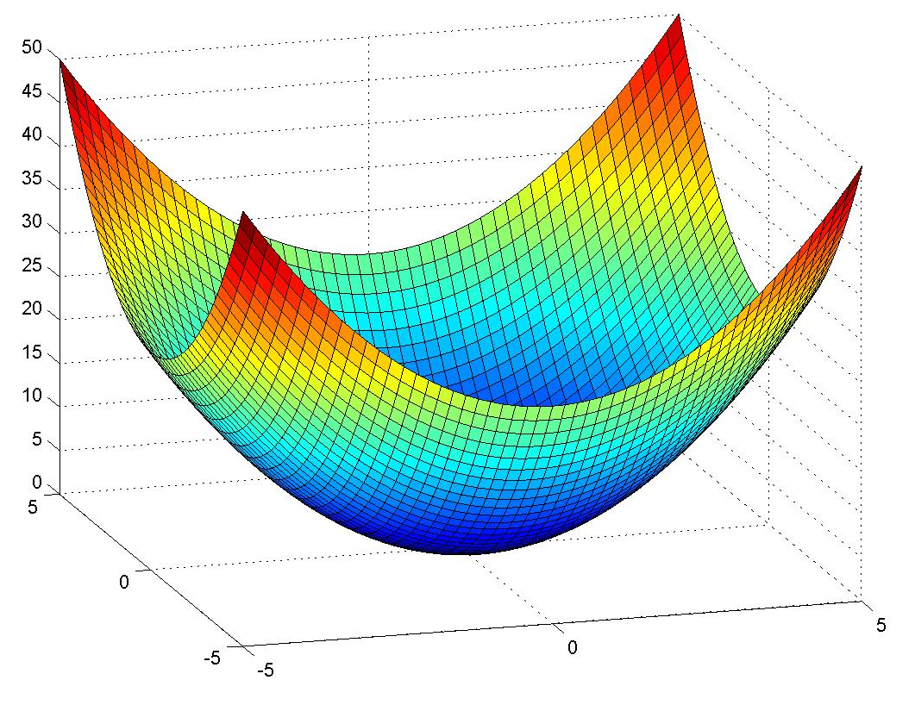
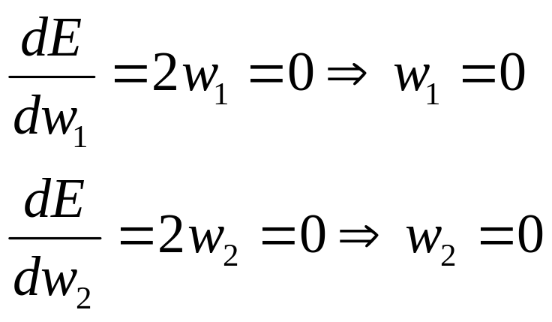
Unconstrained Optimization
  E(w₁,w₂) = w₁² + w₂²
E(w₁,w₂)
w₁=0, w₂=0 minimizes E(w₁,w₂)
Minimum value is E(0,0)=0
w₂
w₁

Slide 12
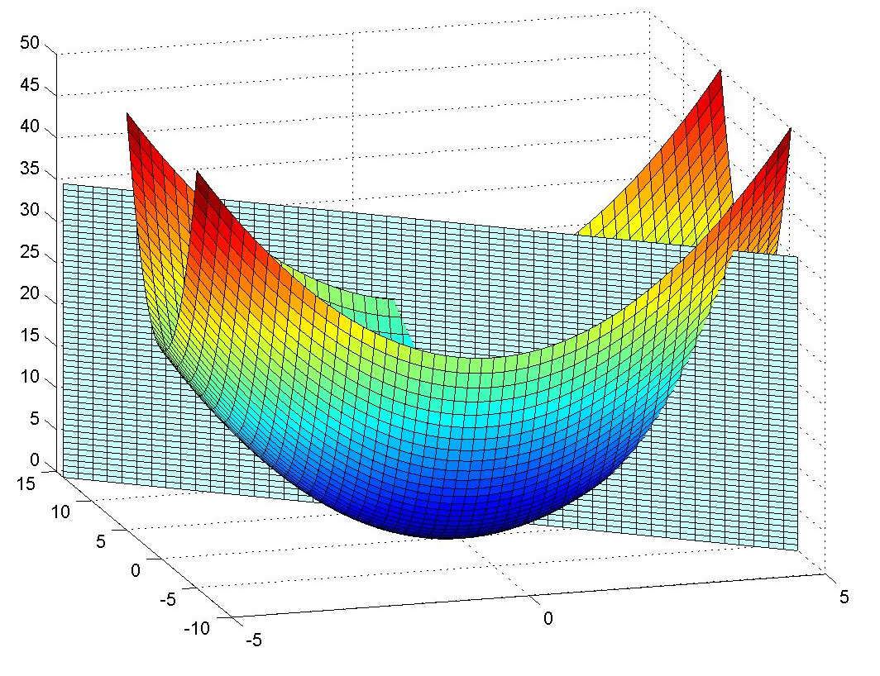
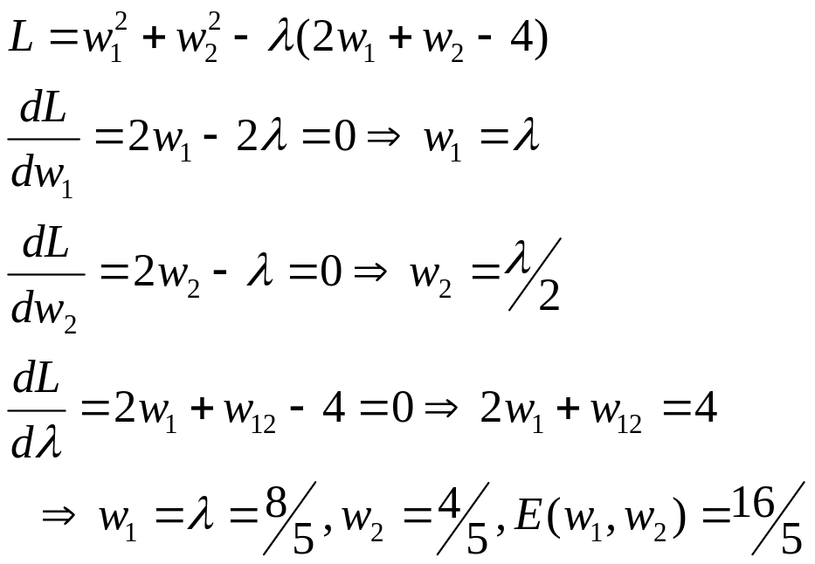
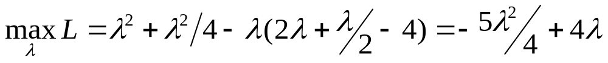
Constrained Optimization
  minimize E(w₁,w₂) = w₁² + w₂²
  subject to 2w₁ + w₂ = 4 (equality constraint)
E(w₁,w₂)
w₂
w₁
Dual problem:

Slide 13
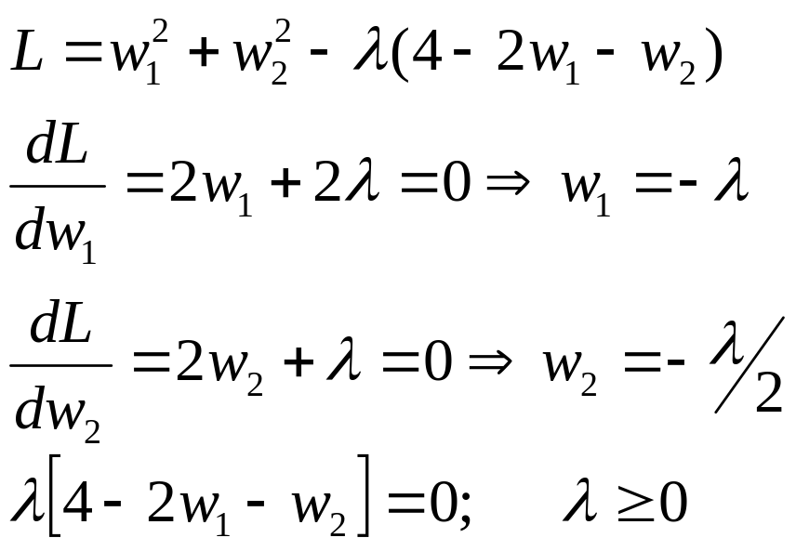
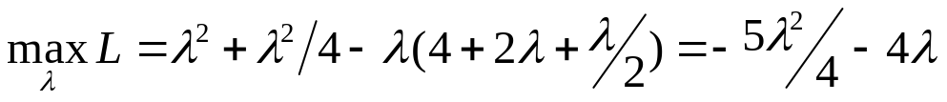
Constrained Optimization
  minimize E(w₁,w₂) = w₁² + w₂²
  subject to 2w₁ + w₂ ≤ 4 (inequality constraint)
E(w₁,w₂)
w₂
w₁
Dual problem:

Slide 14
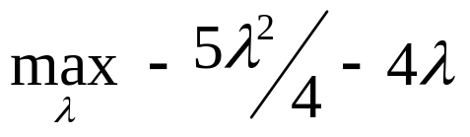
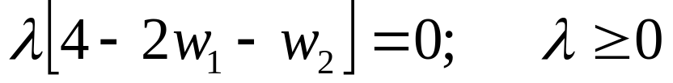
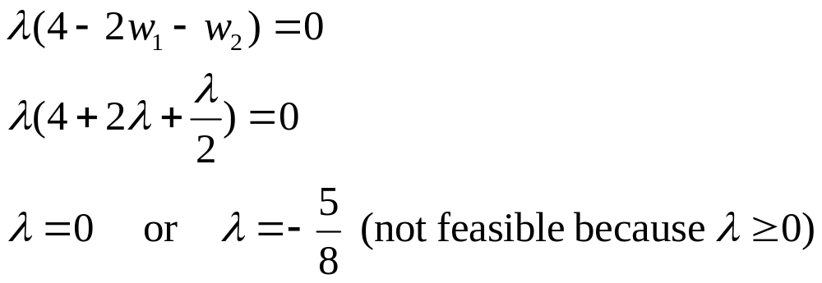

Constrained Optimization
  subject to
E(w₁,w₂)
w₂
w₁

Slide 15
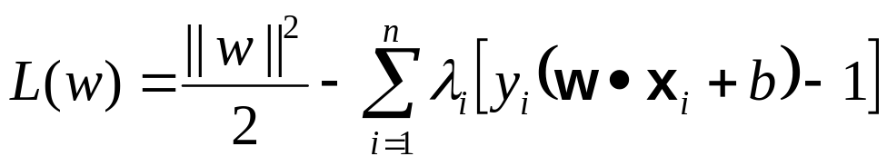
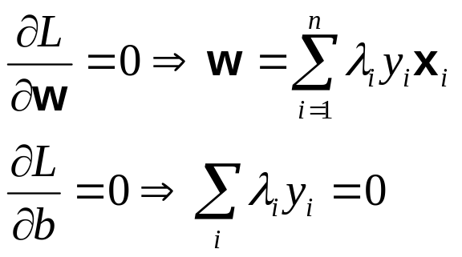
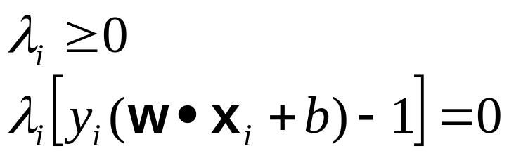
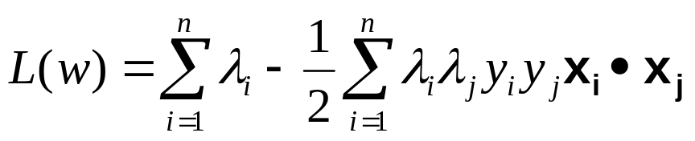
Learning Linear SVM
Lagrange multiplier:
  Take derivative w.r.t λ and b:
  Additional constraints:
  Dual problem:

Slide 16
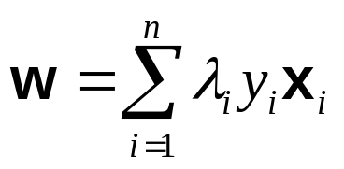
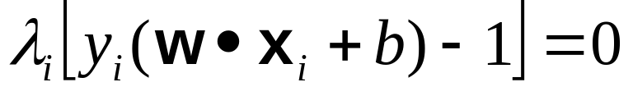
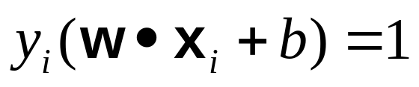
Learning Linear SVM
To find the decision boundary, the learning algorithm needs to find w and b
  To solve for w:
  Furthermore:
    λ is zero for points that do not reside on
    Data points where λs are not zero are called support vectors

Slide 17

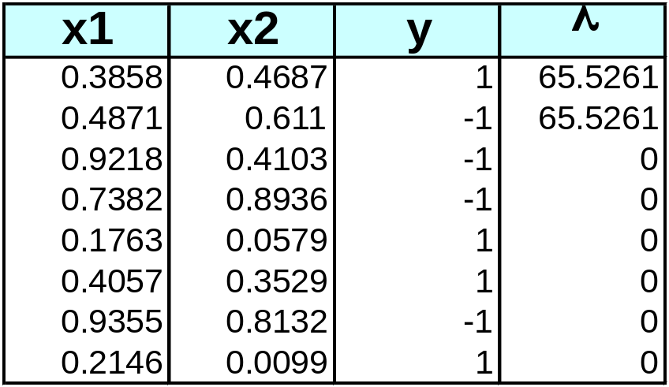
Example of Linear SVM
Support vectors

Slide 18
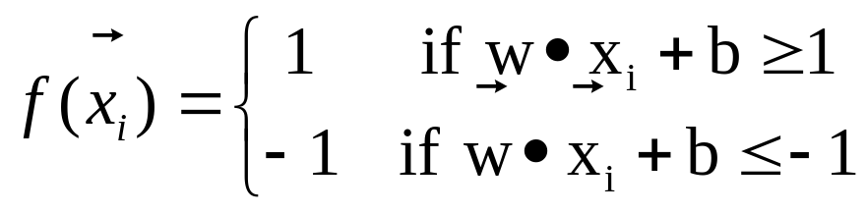
Learning Linear SVM
Decision boundary depends only on support vectors
  If you have data set with same support vectors, decision boundary will not change
  How to classify using SVM once w and b are found? Given a test record, x_{i}

Slide 19
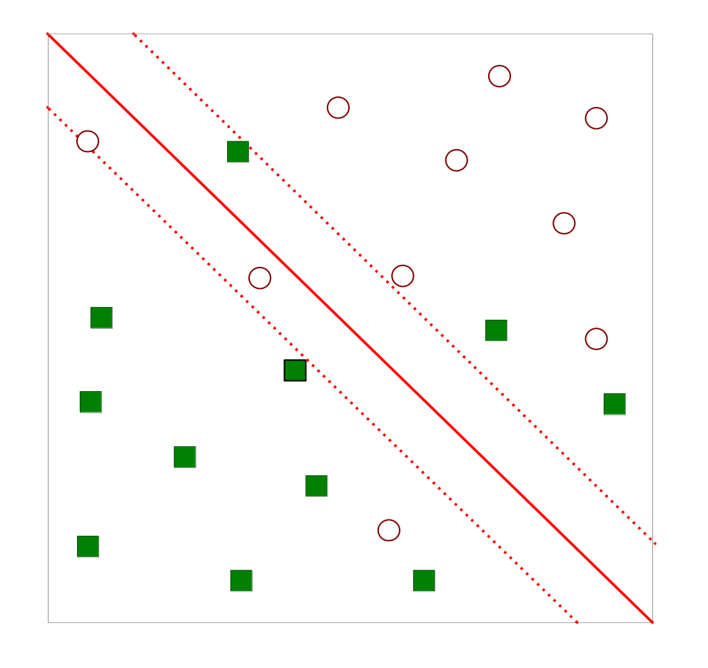
Support Vector Machines
What if the problem is not linearly separable?

Slide 20
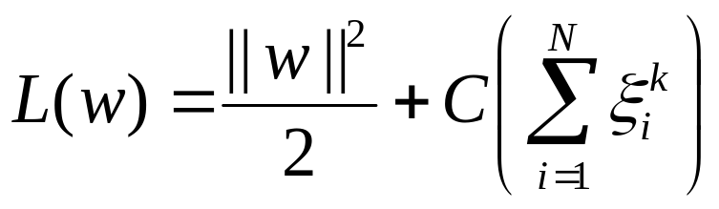
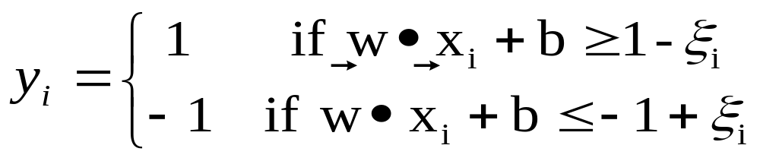
Support Vector Machines
What if the problem is not linearly separable?
  Introduce slack variables
    Need to minimize:
    Subject to:
    If k is 1 or 2, this leads to same objective function as linear SVM but with different constraints (see textbook)

Slide 21
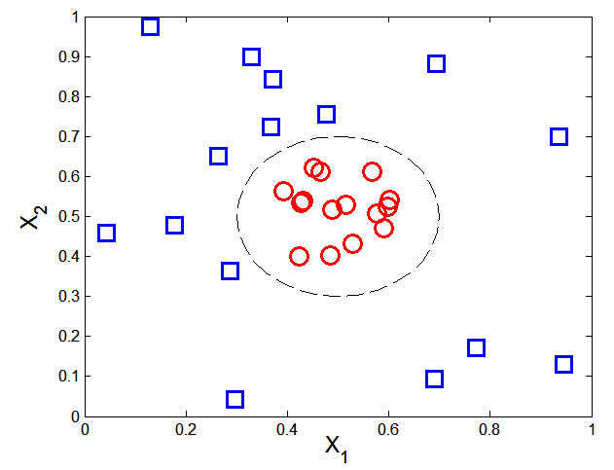

Nonlinear Support Vector Machines
What if decision boundary is not linear?

Slide 22
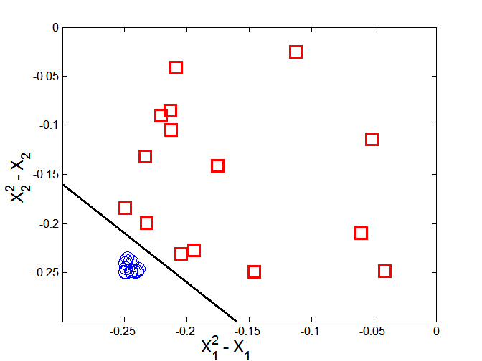



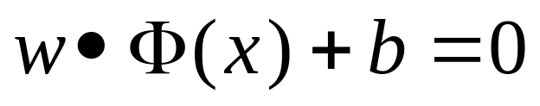
Nonlinear Support Vector Machines
Trick: Transform data into higher dimensional space
Decision boundary:

Slide 23
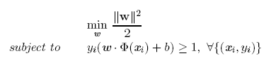

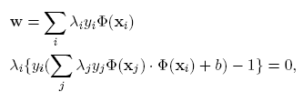

Learning Nonlinear SVM
Optimization problem:
Which leads to the same set of equations (but involve Φ(x) instead of x)

Slide 24
Learning NonLinear SVM
Issues:
  What type of mapping function Φ should be used?
  How to do the computation in high dimensional space?
    Most computations involve dot product Φ(x_{i})• Φ(x_{j})
    Curse of dimensionality?

Slide 25

Learning Nonlinear SVM
Kernel Trick:
  Φ(x_{i})• Φ(x_{j}) = K(x_{i}, x_{j})
  K(x_{i}, x_{j}) is a kernel function (expressed in terms of the coordinates in the original space)
    Examples:

Slide 26
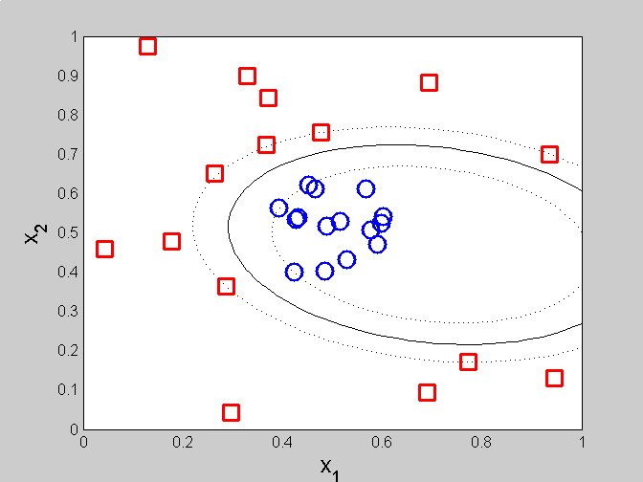
Example of Nonlinear SVM
SVM with polynomial degree 2 kernel

Slide 27
Learning Nonlinear SVM
Advantages of using kernel:
  Don’t have to know the mapping function Φ
  Computing dot product Φ(x_{i})• Φ(x_{j}) in the original space avoids curse of dimensionality
Not all functions can be kernels
  Must make sure there is a corresponding Φ in some high-dimensional space
  Mercer’s theorem (see textbook)

Slide 28
Ensemble Methods
Construct a set of classifiers from the training data
Predict class label of test records by combining the predictions made by multiple classifiers

Slide 29
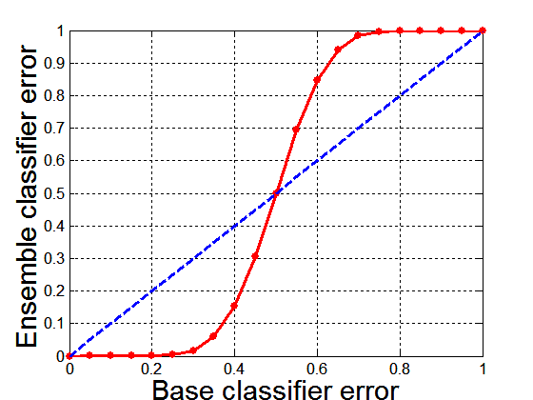
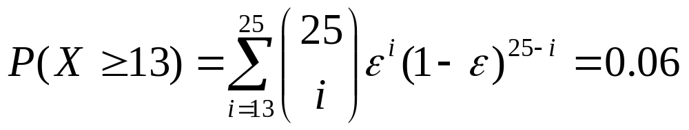
Why Ensemble Methods work?
Suppose there are 25 base classifiers
  Each classifier has
  error rate, ε = 0.35
  Assume errors made
  by classifiers are uncorrelated
  Probability that the ensemble classifier makes a wrong prediction:

Slide 30
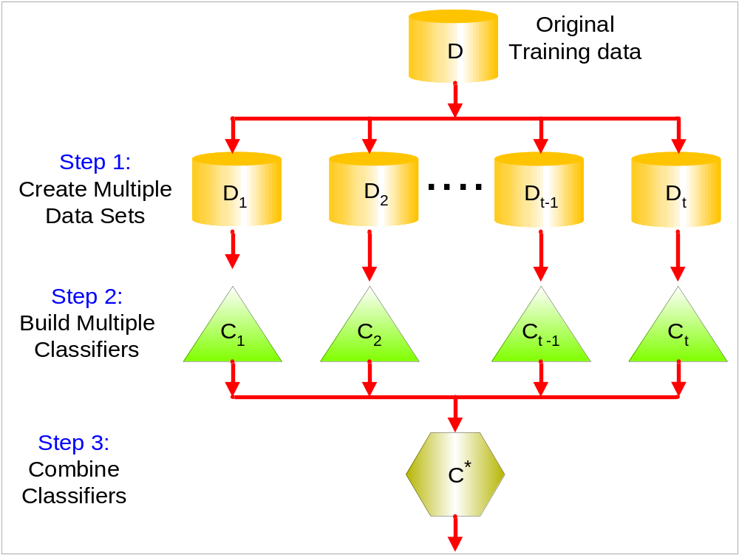
General Approach

Slide 31
Types of Ensemble Methods
Bayesian ensemble
  Example: Mixture of Gaussian
Manipulate data distribution
  Example: Resampling method
Manipulate input features
  Example: Feature subset selection
Manipulate class labels
  Example: error-correcting output coding
Introduce randomness into learning algorithm
  Example: Random forests

Slide 32
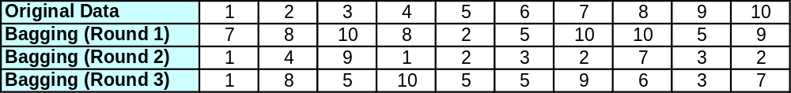
Bagging
Sampling with replacement
Build classifier on each bootstrap sample
Each sample has probability (1 – 1/n)^{n} of being selected

Slide 33
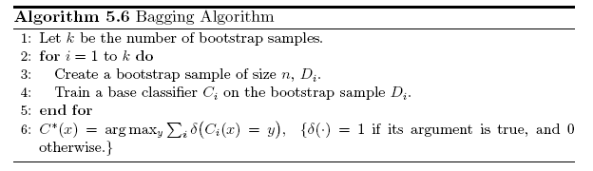
Bagging Algorithm

Slide 34
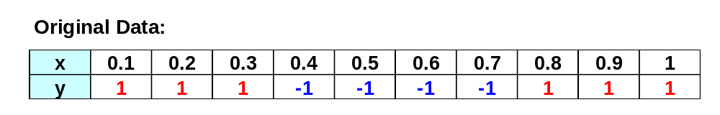
Bagging Example
Consider 1-dimensional data set:
Classifier is a decision stump
  Decision rule: x ≤ k versus x > k
  Split point k is chosen based on entropy
x ≤ k
True
False
y_{left}
y_{right}

Slide 35
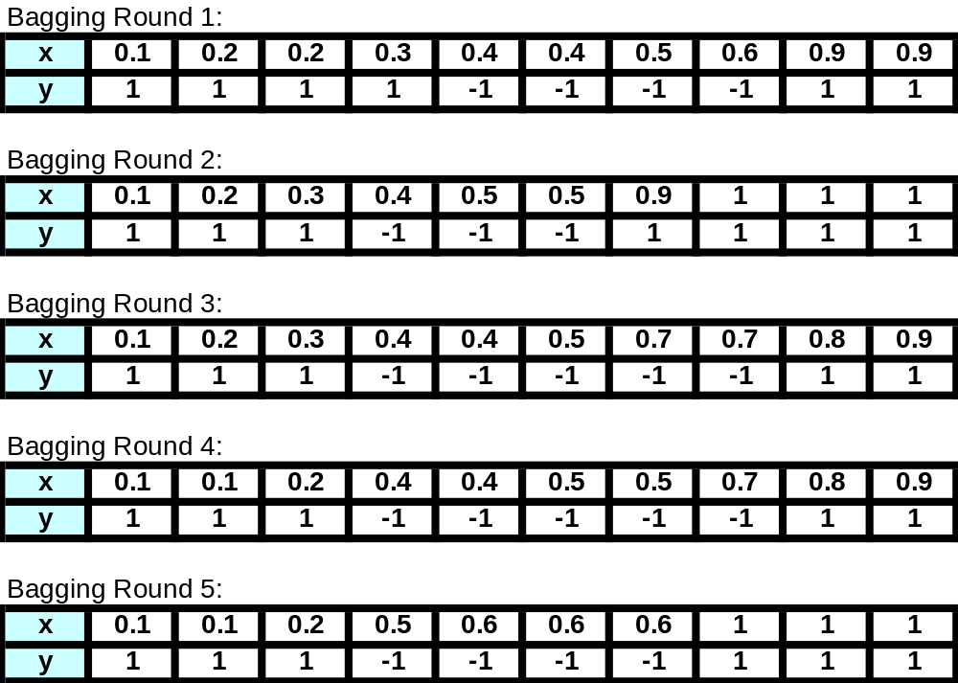
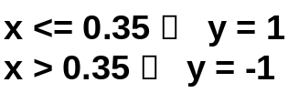
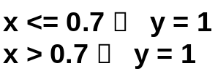
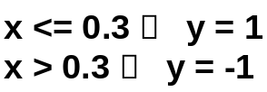
Bagging Example

Slide 36
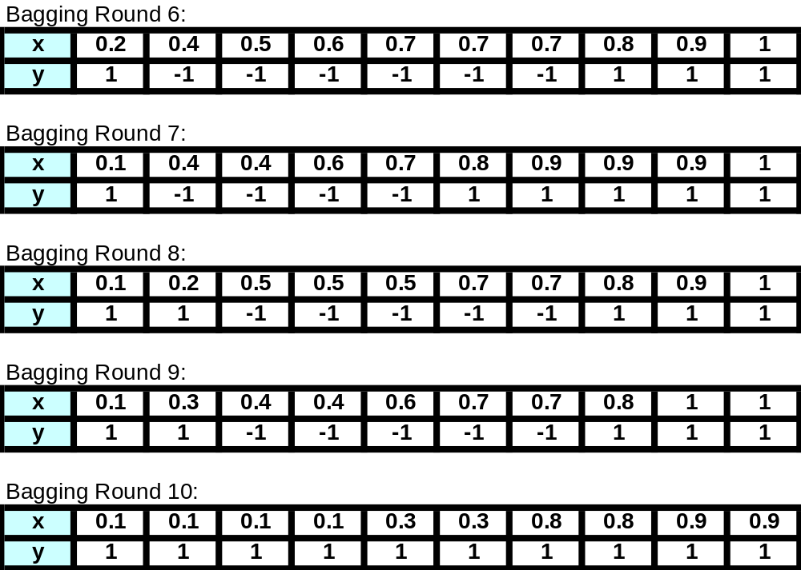


Bagging Example

Slide 37

Bagging Example
Summary of Training sets:

Slide 38

Bagging Example
Assume test set is the same as the original data
Use majority vote to determine class of ensemble classifier
Predicted Class

Slide 39
Boosting
An iterative procedure to adaptively change distribution of training data by focusing more on previously misclassified records
  Initially, all N records are assigned equal weights
  Unlike bagging, weights may change at the end of each boosting round

Slide 40

Boosting
Records that are wrongly classified will have their weights increased
Records that are classified correctly will have their weights decreased
Example 4 is hard to classify
Its weight is increased, therefore it is more likely to be chosen again in subsequent rounds

Slide 41



AdaBoost
Base classifiers: C₁, C₂, …, C_{T}
Error rate:
Importance of a classifier:

Slide 42


AdaBoost Algorithm
Weight update:
If any intermediate rounds produce error rate higher than 50%, the weights are reverted back to 1/n and the resampling procedure is repeated
Classification:

Slide 43

AdaBoost Algorithm

Slide 44
AdaBoost Example
Consider 1-dimensional data set:
Classifier is a decision stump
  Decision rule: x ≤ k versus x > k
  Split point k is chosen based on entropy
x ≤ k
True
False
y_{left}
y_{right}

Slide 45


AdaBoost Example
Training sets for the first 3 boosting rounds:
Summary:

Slide 46


AdaBoost Example
Weights
Classification
Predicted Class

